Slide 1
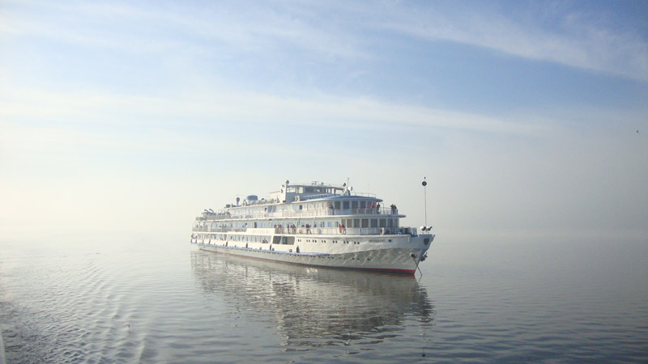
A voyage up the Volga
Сотникова Наталья Сергеевна
Учитель МОАУ «Гимназия № 3 г Орска»

Slide 2

All roads lead to Rome
Every country has its customs
So many countries, so many customs

Slide 3

When at Rome, do as Romans do
Better to see something once, than to hear about it a thousand times
East or West, home is best

Slide 4


Slide 5
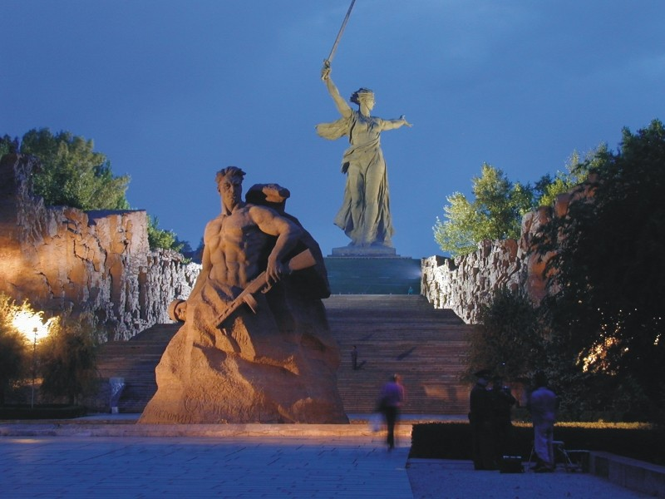
Volgograd
Mamaev Kurgan
(The Motherland Calls)

Slide 6
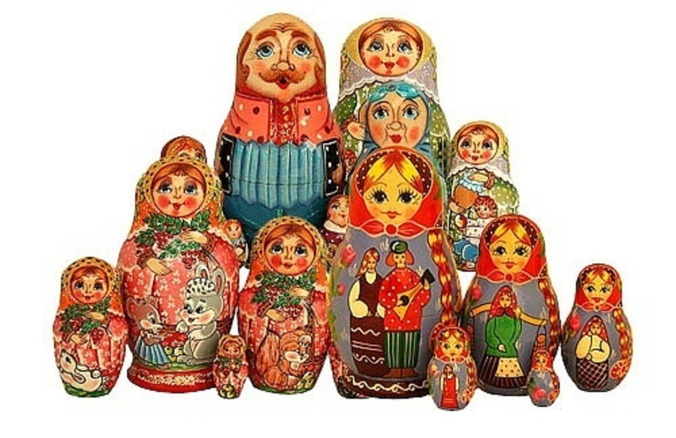
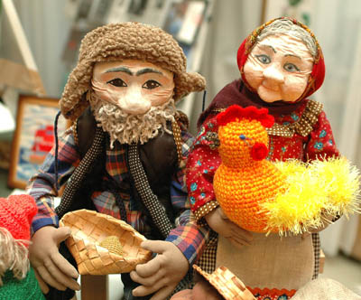
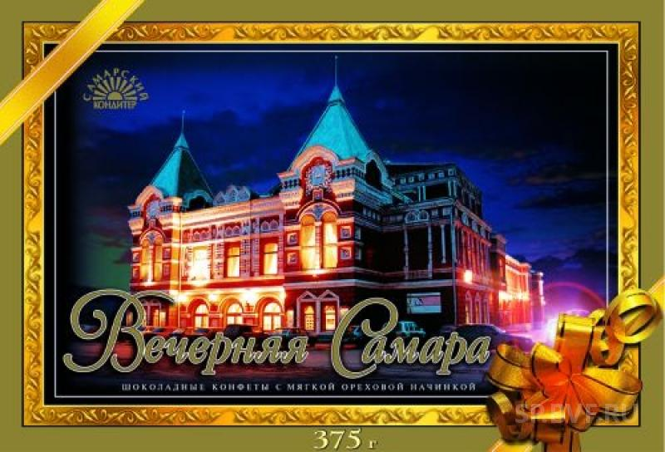
Saratov, Samara,
Ulyanovsk

Slide 7
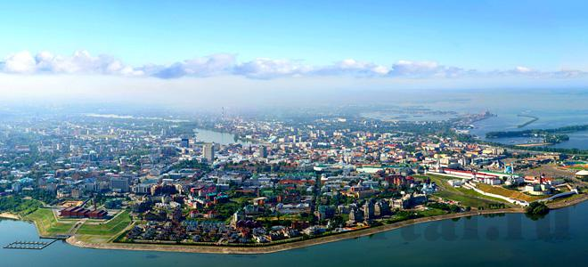
Kazan

Slide 8
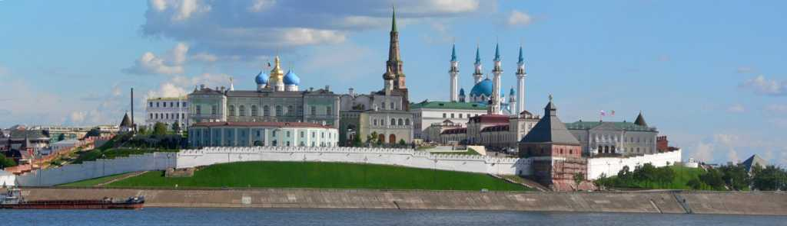
The Kazan Kremlin

Slide 9
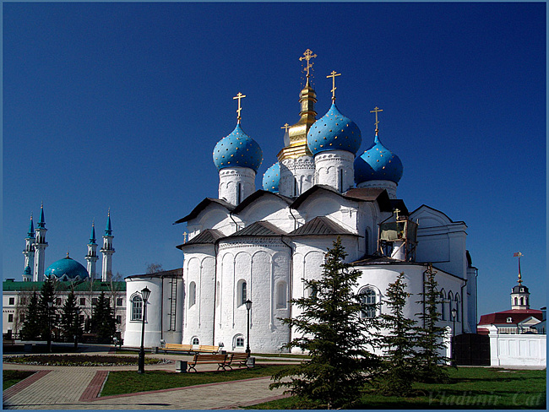
The Annunciation Cathedral

Slide 10
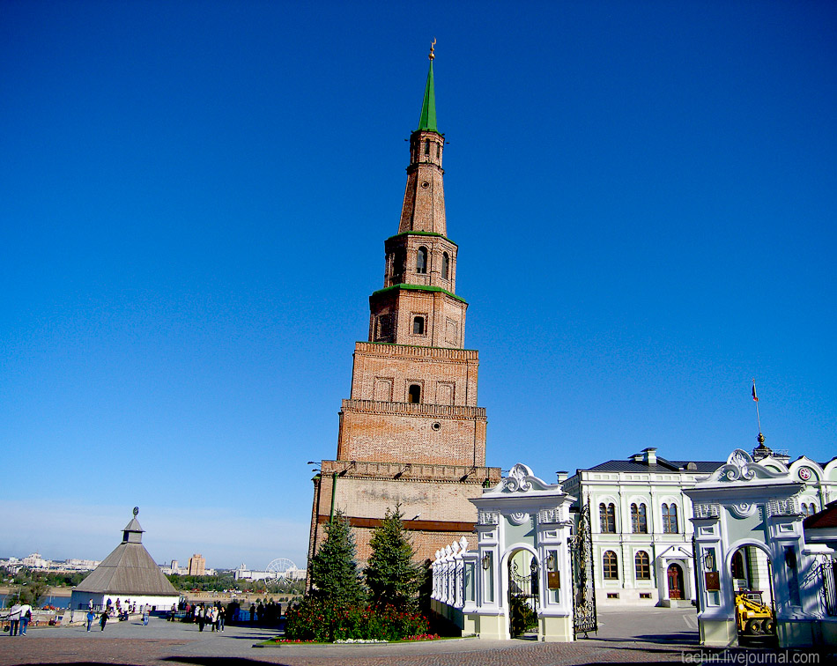
Soyembika Tower

Slide 11
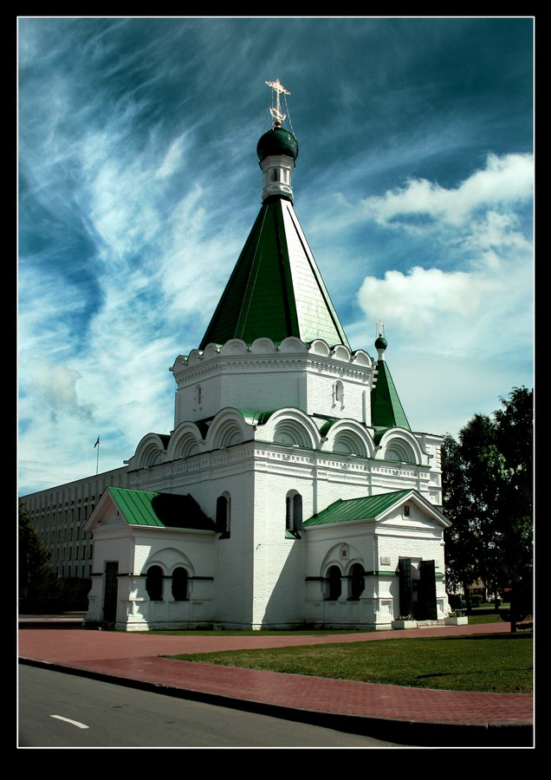
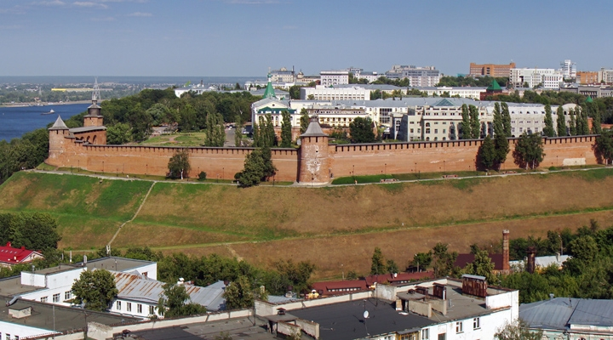
The Archangel Cathedral
The Kremlin
Nizhny Novgorod

Slide 12
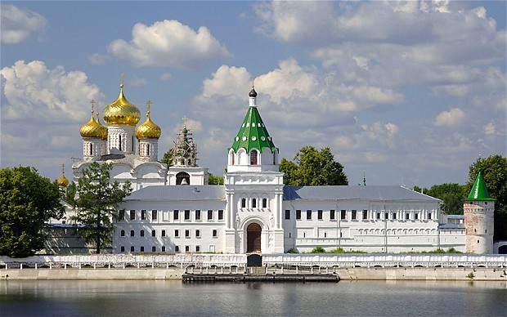
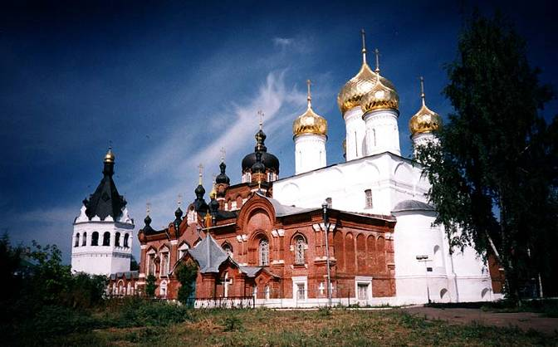
Kostroma

Slide 13
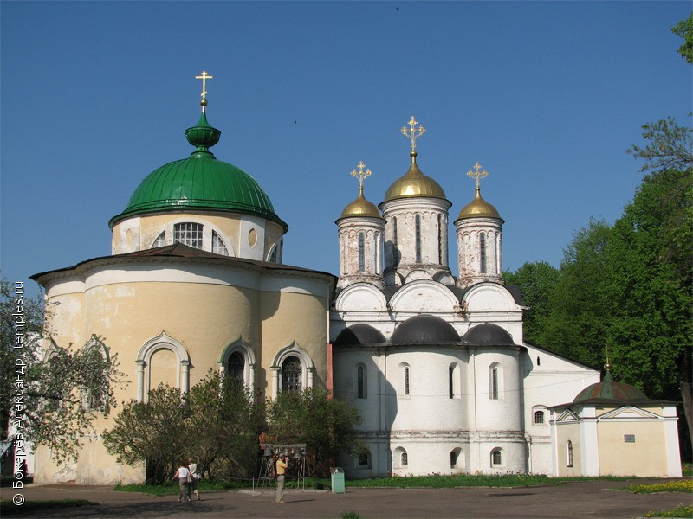
Yaroslavl
The Spaso-Preobrazhensky Monastery

Slide 14
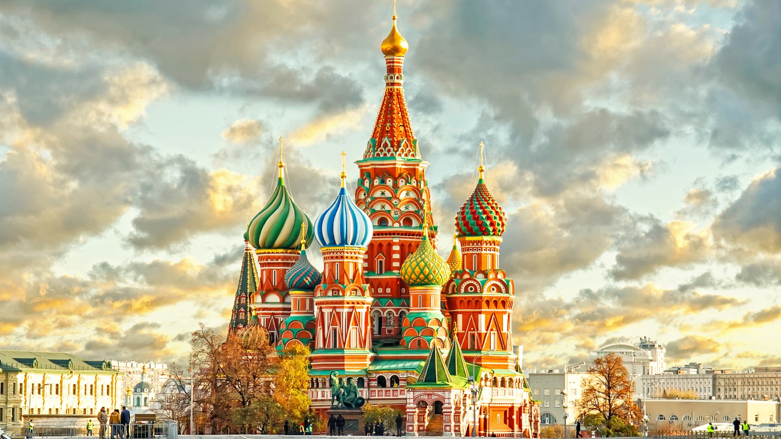
Moscow

Slide 15

Group A: What a travel agent MUST possess, what skills he NEEDS and SHOULD have

Slide 16
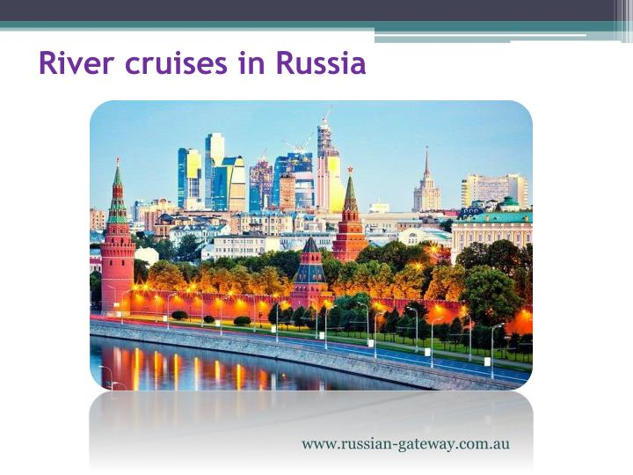
Group B:Study the advertisement.
1) dates for departures
2) the most popular sights of the city
3) number of people in the trip
4) number of city tours
5) discounts

Slide 17
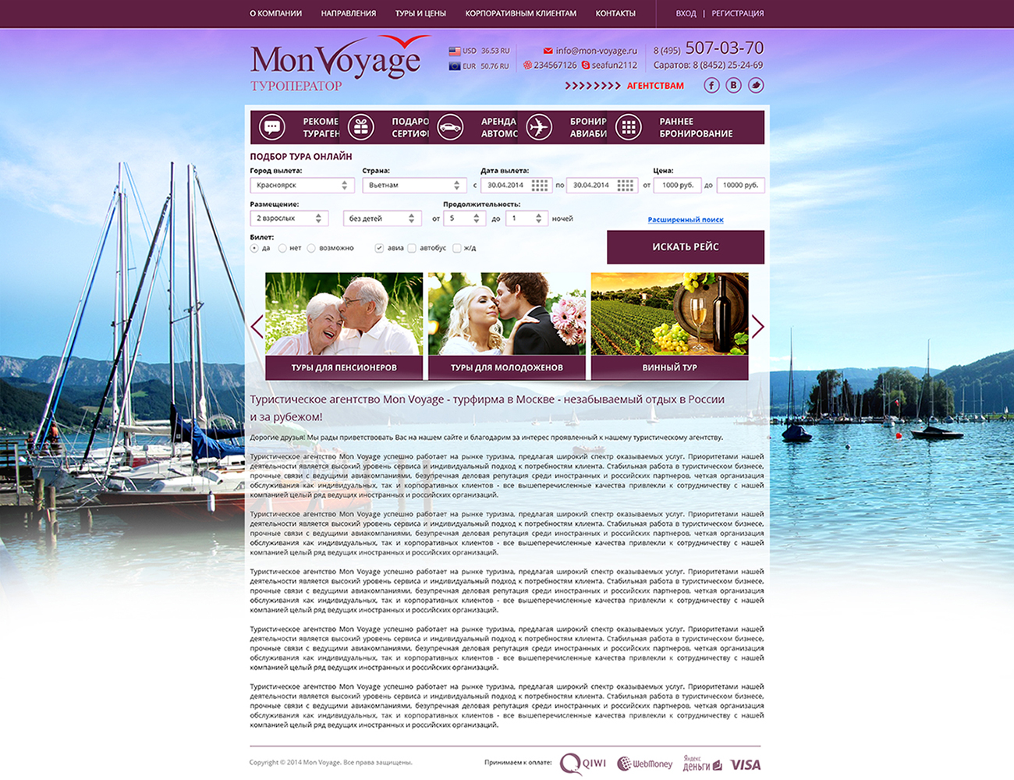
Group C: Write the leaflet “A voyage up the Volga”.

Slide 18

Home task
write an email about your voyage up the Volga

